Slide 1
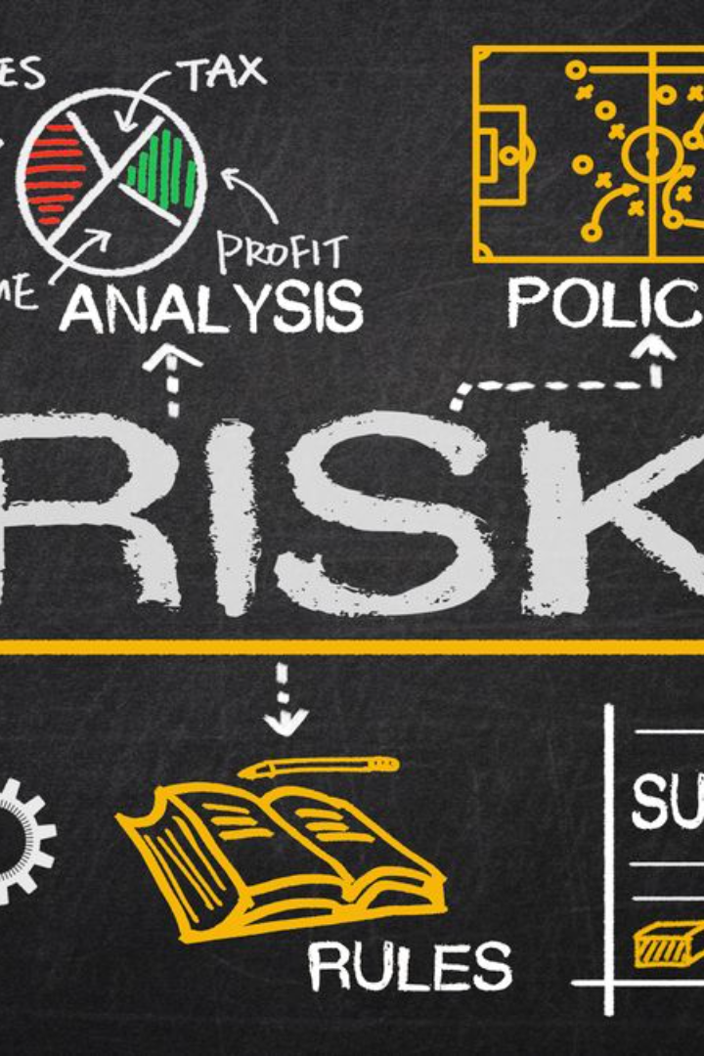
Risk Management: A Guide to Success
Discover how to identify potential risks, develop strategies for risk mitigation, and understand the impact of risk on your project outcomes.

Slide 2

The Power of Risk Identification
Foreseeing Challenges
Preparation is Key
Anticipate potential risks to avoid unexpected setbacks.
Be proactive by identifying risks early for better risk planning.
Ensuring Continuity
Identify risks that might disrupt your project's progress.

Slide 3

Strategies for Effective Risk Mitigation
1
Analyzing and Prioritizing
2
Collaboration & Communication
Assess risks and prioritize them according to their potential impact.
Establish effective communication channels to address risks and implement mitigation strategies.
3
Implementing Controls
Develop and enforce controls to minimize the impact of identified risks.

Slide 4



The Ripple Effect: Impact of Risk on Project Outcomes
Impeding Your Progress
Budgetary Burdens
Jeopardizing Quality
Understand how risks can influence project timelines and deliverables.
Discover the financial implications of unmanaged risks on project budgets.
Learn how risks can compromise project quality assurance and customer satisfaction.

Slide 5
Tackling Risks: A Step-by-Step Approach
1
Evaluation
Analyze and assess potential risks in your project.
Mitigation Planning
2
Create a detailed mitigation plan to address identified risks.
3
Implementation
Execute the planned strategies to mitigate risks effectively.

Slide 6
Building a Resilient Team
Effective Leadership
Open Communication
Establish strong leadership to guide the team through uncertainty.
Promote transparent and open communication to identify risks collectively.
Continuous Improvement
Encourage a culture of learning and adaptability to tackle emerging risks.

Slide 7


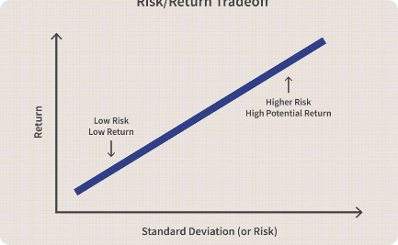
Real-Life Examples: Risk Management in Action
Construction Projects
Cybersecurity
Financial Markets
Explore risk management strategies in the construction industry.
Discover how industries combat threats through risk management.
Learn how risk identification preserves stability in the financial sector.

Slide 8

Driving Success Through Risk Management
Maximize opportunities while minimizing potential risks.
Empower your team to handle uncertainties with confidence.
Achieve project goals by staying one step ahead of challenges.

